Slide 1
Slide Template for ACP2024 - widescreen
Author¹, Author ² and Author^{1,2}.
¹Affiliation 1
²Affiliaiton 2

Slide 2
Using this template
If your presentation is already made you can easily apply this template
Save this template on your computer
Follow the steps on the following page

Slide 3

1. Open your old presentation

Slide 4

2. Select “Design”

Slide 5

3. Select “More”

Slide 6
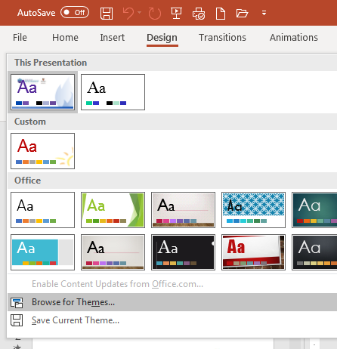
4. Select “Browse for Themes”

Slide 7
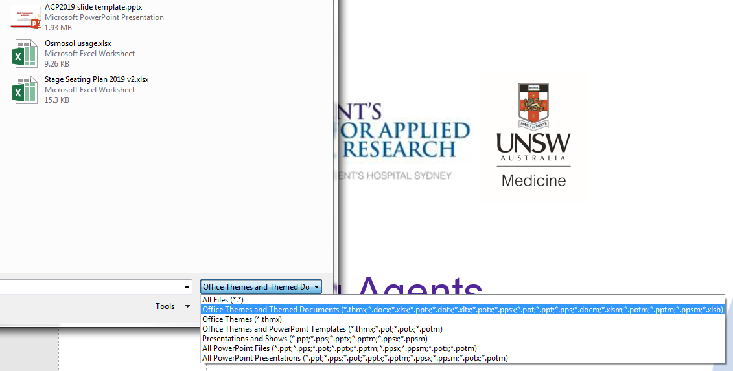
5. Open the Slide Template file
Make sure you have selected
“Office Themes and Themed Documents”

Slide 8
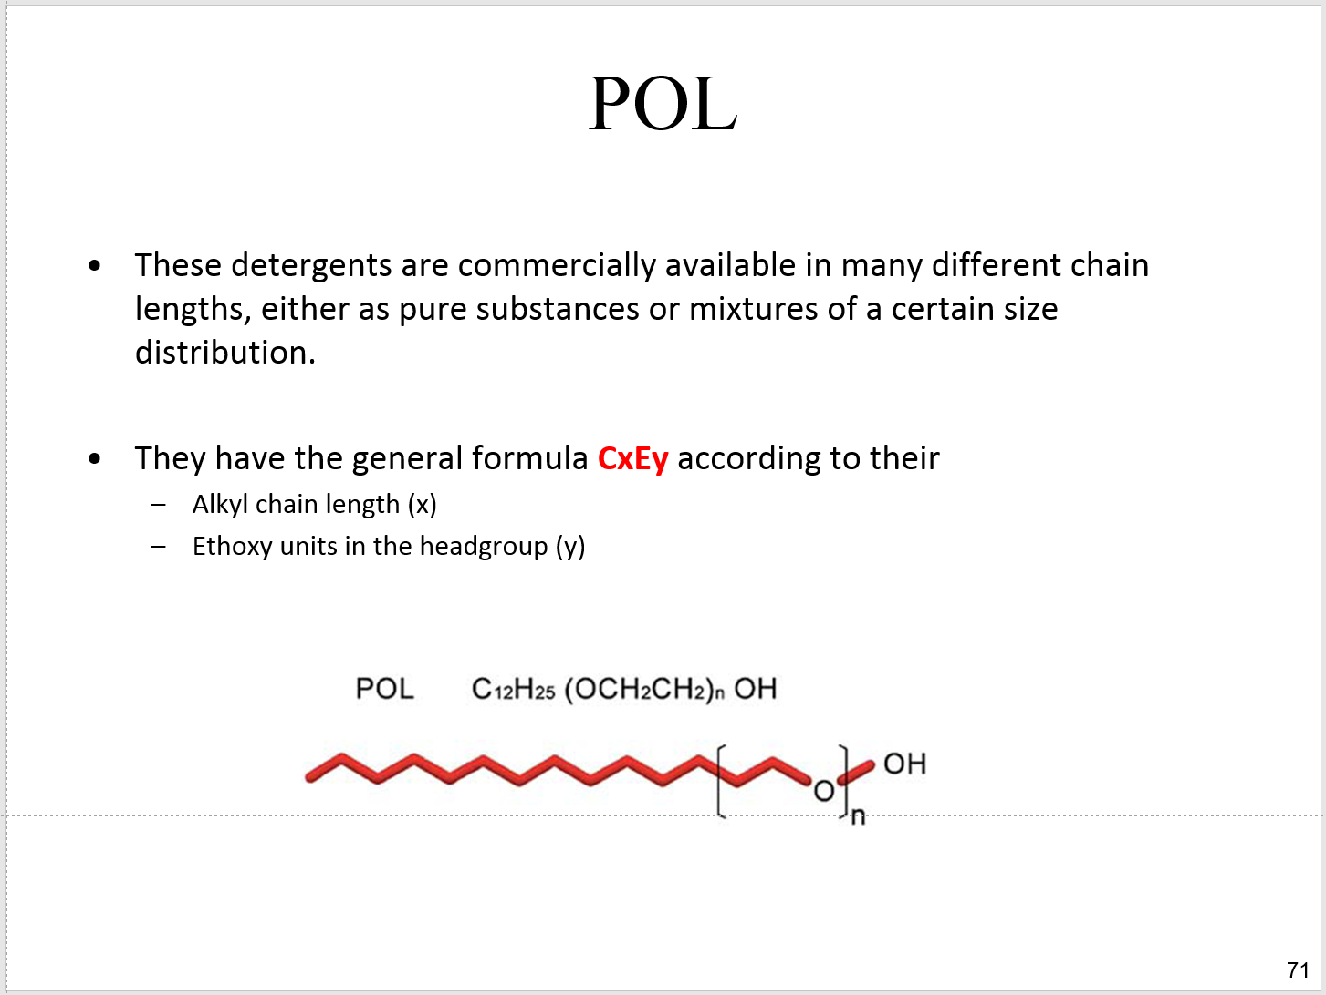
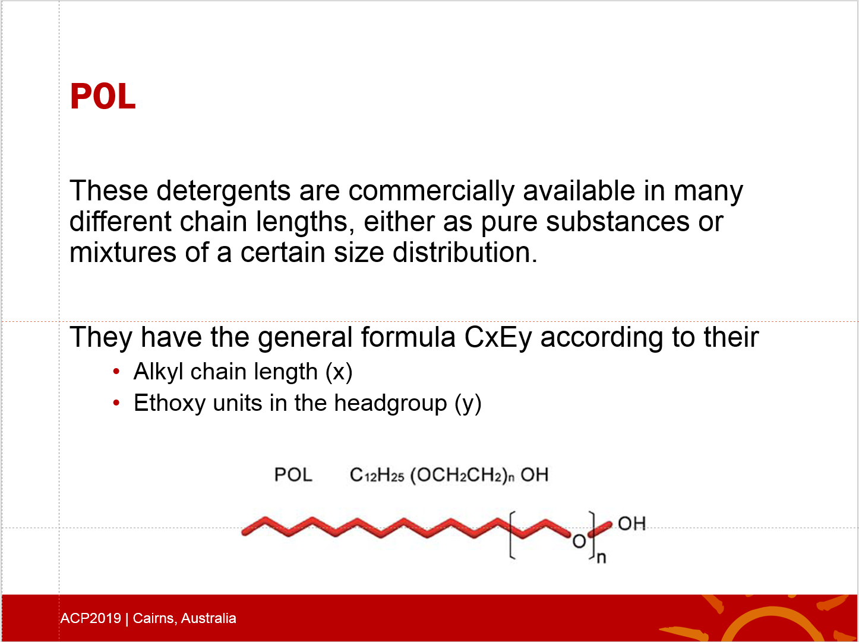
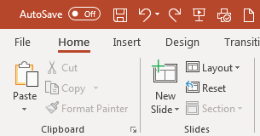
Some slides still won’t look right
In “Home” select “Layout” to make sure the right template is applied or “Reset” to undo any custom formatting

